Slide 1

Application Layer Part 7
Mark Allman
Case / ICSI
EECS 325/425
Fall 2018
“We’re the bad news, we’re the young guns, We’re the ones they told you to run from”

Slide 2

Reading Along ...
X
Allman
Sockets programming
(server side)
2

Slide 3
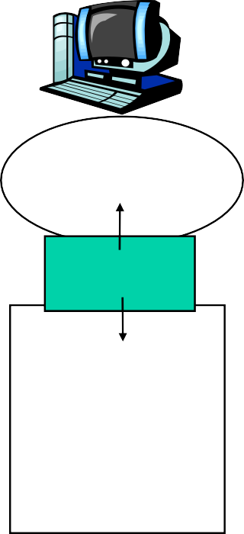

Sockets
Recall that sockets sit between the application process and the transport protocol
host or server
host or server
controlled by app developer
process
process
socket
socket
TCP with buffers, variables
Sockets form the glue that allows processes to interface with transports (and hence all lower layers)
TCP with buffers, variables
Internet
controlled by OS
Allman
3
Application 2-12

Slide 4
Example TCP Server
write
(sd2,msg,strlen
(msg));
4

Slide 5
Example TCP Server
write
(sd2,msg,strlen
(msg));
4

Slide 6
Example TCP Server
sd2 = accept (sd,&addr,&addrlen);
write
(sd2,msg,strlen (msg));
5

Slide 7
Example TCP Server
sd2 = accept (sd,&addr,&addrlen);
write
(sd2,msg,strlen (msg));
5

Slide 8

Example TCP Server
sd = socket(PF_INET, SOCK_STREAM, protoinfo->p_proto);
sd2 = accept (sd,&addr,&addrlen);
write
(sd2,msg,strlen (msg));
6

Slide 9
Example TCP Server
sd = socket(PF_INET, SOCK_STREAM, protoinfo->p_proto);
sd2 = accept (sd,&addr,&addrlen);
write
(sd2,msg,strlen (msg));
6

Slide 10
Example TCP Server
protoinfo = getprotobyname (“tcp”);
sd = socket(PF_INET, SOCK_STREAM, protoinfo->p_proto);
sd2 = accept (sd,&addr,&addrlen);
write
(sd2,msg,strlen (msg));
7

Slide 11
Example TCP Server
protoinfo = getprotobyname (“tcp”);
sd = socket(PF_INET, SOCK_STREAM, protoinfo->p_proto);
listen
sd2 = write
(sd,
QLEN);
accept (sd,&addr,&addrlen);
(sd2,msg,strlen (msg));
8

Slide 12
Example TCP Server
protoinfo = getprotobyname (“tcp”);
sd = socket(PF_INET, SOCK_STREAM, protoinfo->p_proto);
listen
sd2 = write
(sd,
QLEN);
accept (sd,&addr,&addrlen);
(sd2,msg,strlen (msg));
8

Slide 13
Example TCP Server
protoinfo = getprotobyname (“tcp”);
sd = socket(PF_INET, SOCK_STREAM, protoinfo->p_proto);
bind (sd, (struct sockaddr *)&sin, sizeof(sin));
listen (sd, QLEN);
sd2 = accept (sd,&addr,&addrlen);
write
(sd2,msg,strlen (msg));
9

Slide 14
Example TCP Server
protoinfo = getprotobyname (“tcp”);
sd = socket(PF_INET, SOCK_STREAM, protoinfo->p_proto);
bind (sd, (struct sockaddr *)&sin, sizeof(sin));
listen (sd, QLEN);
sd2 = accept (sd,&addr,&addrlen);
write
(sd2,msg,strlen (msg));
10

Slide 15
Example TCP Server
protoinfo = getprotobyname (“tcp”);
sd = socket(PF_INET, SOCK_STREAM, protoinfo->p_proto);
bind (sd, (struct sockaddr *)&sin, sizeof(sin));
listen (sd, QLEN);
sd2 = accept (sd,&addr,&addrlen);
write
(sd2,msg,strlen (msg));
10

Slide 16
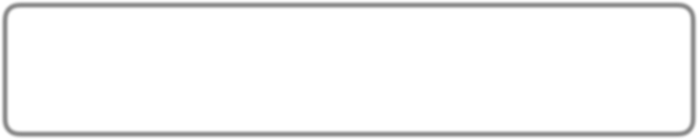
Example TCP Server
protoinfo = getprotobyname (“tcp”);
sd = socket(PF_INET, SOCK_STREAM, protoinfo->p_proto);
/* setup endpoint info */
memset ((char *)&sin,0x0,sizeof (sin)); sin.sin_family = AF_INET; sin.sin_addr.s_addr = INADDR_ANY;
sin.sin_port = htons ((u_short) atoi (argv [PORT_POS]));
bind (sd, (struct sockaddr *)&sin, sizeof(sin)); listen (sd, QLEN);
sd2 = accept (sd,&addr,&addrlen); write (sd2,msg,strlen (msg));

Slide 17
Example TCP Server
protoinfo = getprotobyname (“tcp”);
sd = socket(PF_INET, SOCK_STREAM, protoinfo->p_proto);
/* setup endpoint info */
memset ((char *)&sin,0x0,sizeof (sin)); sin.sin_family = AF_INET; sin.sin_addr.s_addr = INADDR_ANY;
sin.sin_port = htons ((u_short) atoi (argv [PORT_POS]));
bind (sd, (struct sockaddr *)&sin, sizeof(sin)); listen (sd, QLEN);
sd2 = accept (sd,&addr,&addrlen); write (sd2,msg,strlen (msg));
BAD CODING
PRACTICE!

Slide 18
Error Checking
sd | = socket(PF_INET, | SOCK_STREAM, protoinfo->p_proto);
if | (sd < 0)
 | errexit ("cannot | create socket");
if (bind
(sd, (struct
sockaddr
*)&sin, sizeof(sin)) < 0)
errexit ("cannot bind to port");

Slide 19
Socket Example
14

Slide 20
Socket Example
Server:
% hostname
eecslab-5
% ./socketsd
1947 "hello world"
14

Slide 21
Socket Example
Server:
% hostname
eecslab-5
% ./socketsd
1947 "hello world"
Client:
% hostname
eecslab-6
% ./sockets
hello world
eecslab-5.case.edu
1947
14

